Slide 1

POWER AND UTILITIES DISTRIBUTION
MANAGEMENT SYSTEM
DAMG 6210 - Team – 9
Shika Shyam 002194543
Alisha Mary Angalan 002102014
Pranjal Gupta 001094676
Prathamesh Sahasrabudhe 002117703
Sreeharsha Katta 002105642

Slide 2

CONTENTS
01
Objective and Goals
02
High Level Design
03
Database Design and ER-Diagram
04
Database Objects - Highlights
05
Dashboard
06
GUI

Slide 3

A one stop shop for all the information about the entire supply chain available to the organization leadership at a single glance
Determining metering patterns and billing amounts to determine customers who need help paying bills.
Identifying old assets and equipment that need replacement or maintenance.
Planning and preventing outages in the event of adverse weather events.
Effectively dispatching repair crew to affected area avoiding long outages and hence keeping the customer satisfied.
OBJECTIVES
GOALS
We aim to build a centralized database which consists of all the data pertaining to an electric generation and distribution company viz-a-viz Customer Data, Asset Data, Outage data, Billing data, Metering data, Preventive maintenance data, Repair data, Crew data etc.
We aim to create an intricate linked data lake with all these data which can be queried with ease and used to create valuable visualizations which can be used to optimize the supply chain and consequently, will translate to monetary gains for the company and immense satisfaction for the customer.

Slide 4

High level design
Customer Data
Customer Info, Account details, Billing, Metering, Payments
Equipment Data
Equipment Information, Location, Installations, Repairs
Outage Data
Outage Information, Weather Events, Outage related repairs
Crew Data
Crew Information, Crew Assignments

Slide 5
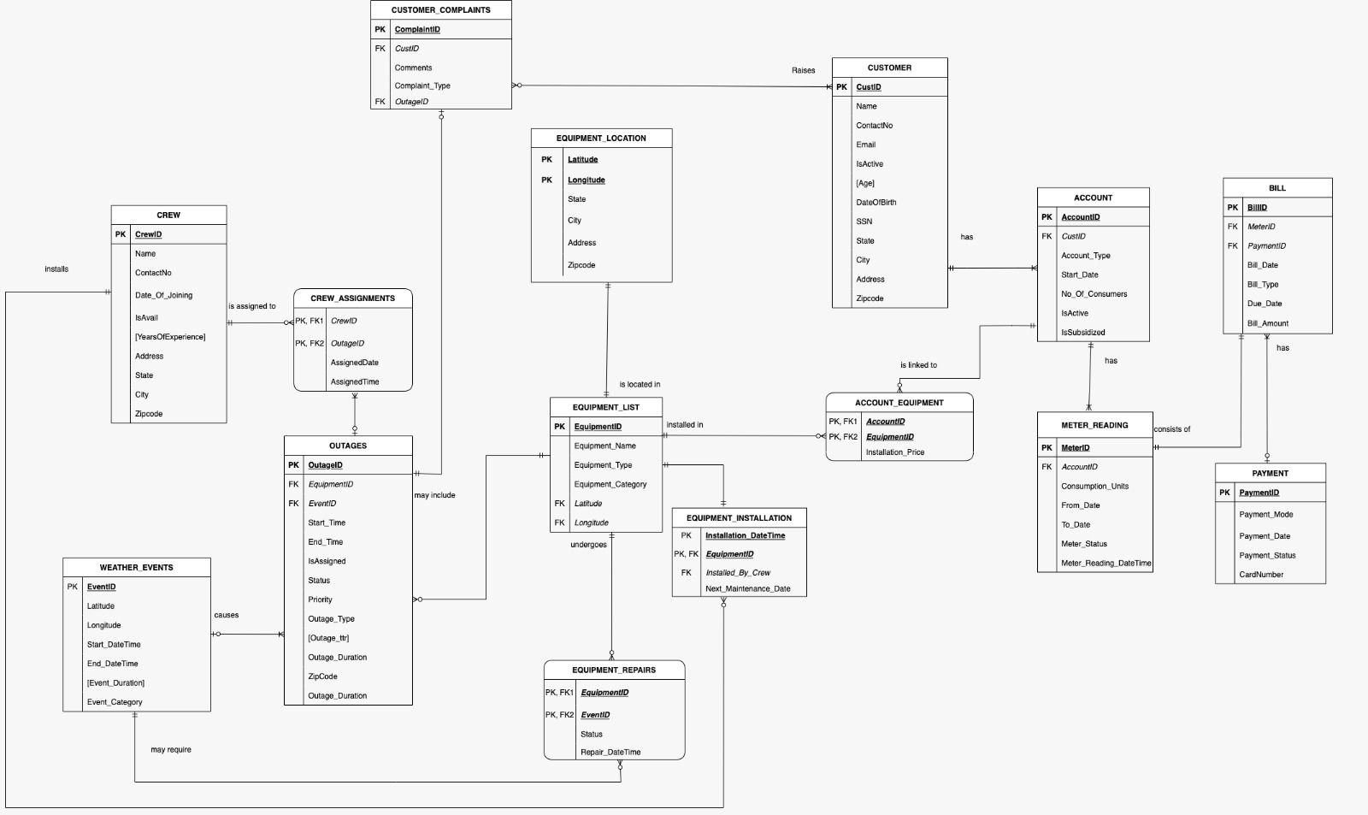
Entity – relationship diagram

Slide 6

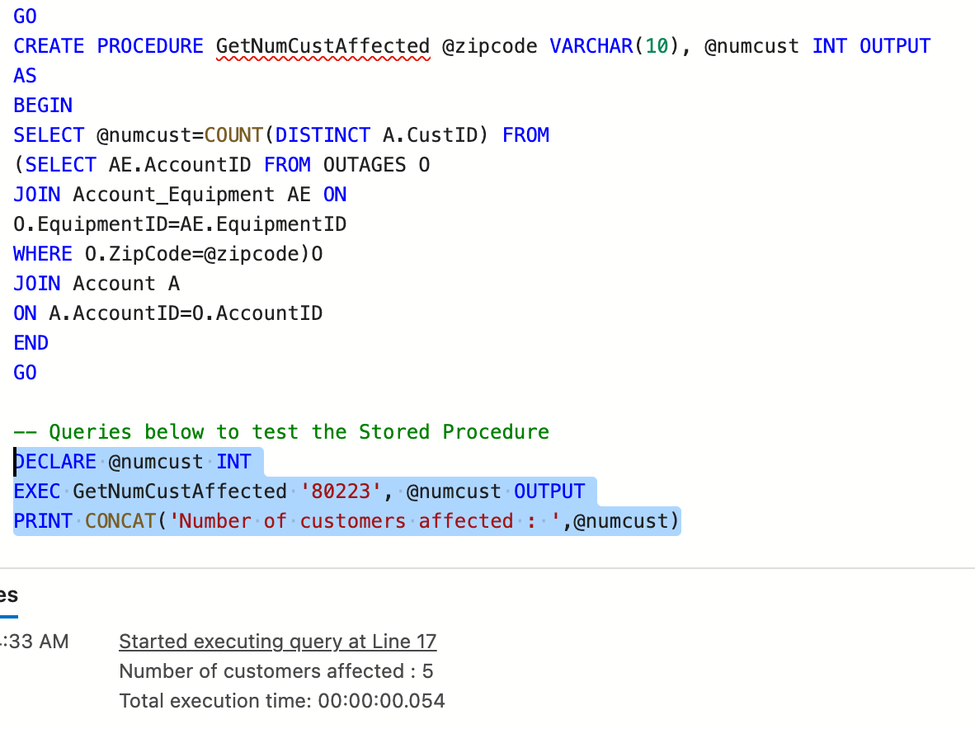
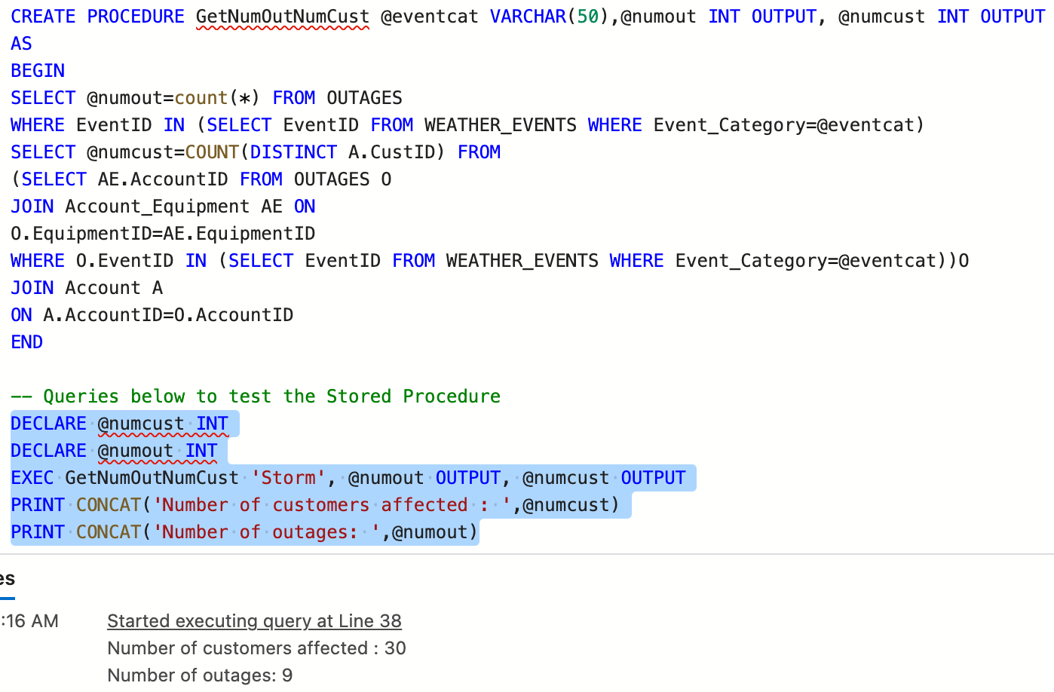
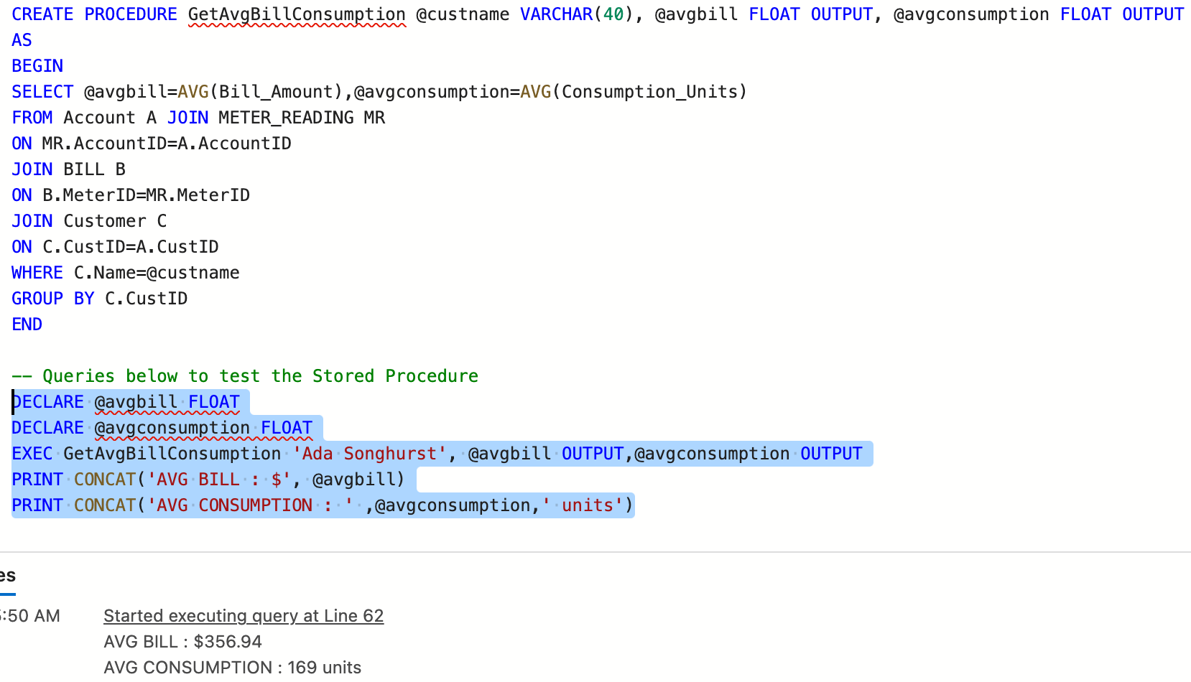
DATABASE OBJECTS – Stored Procedures

Slide 7
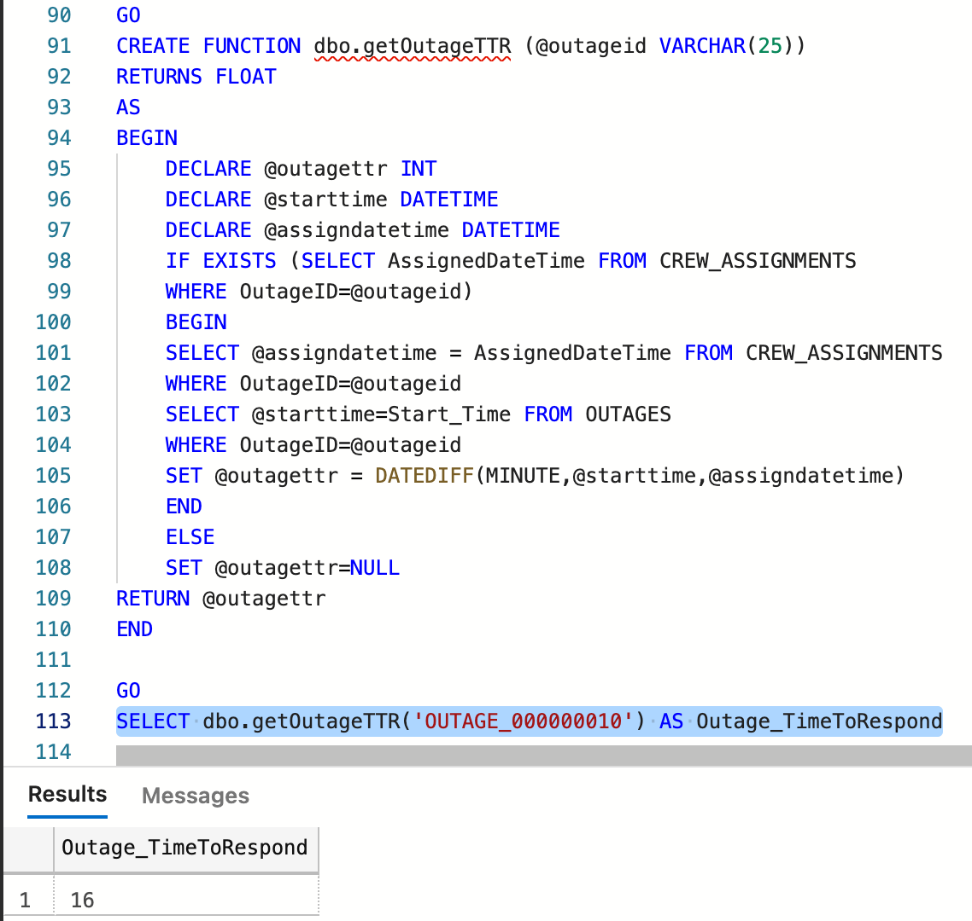
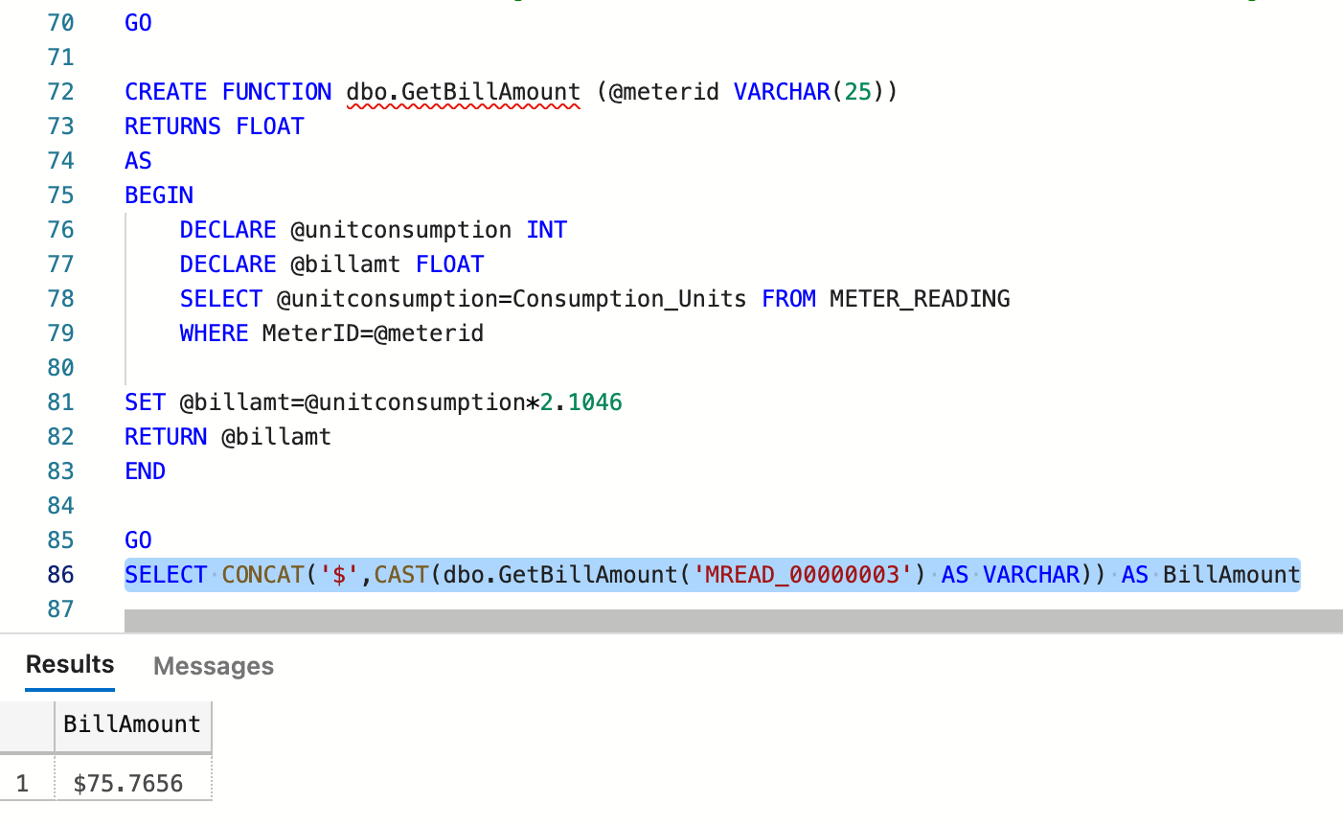
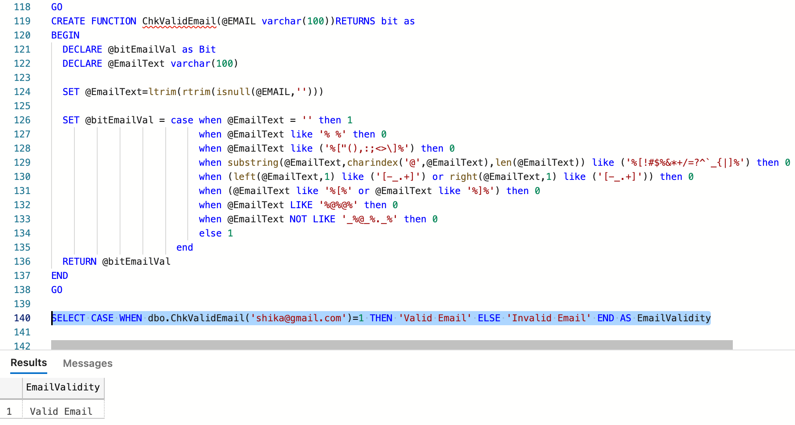
DATABASE OBJECTS – User Defined Functions

Slide 8
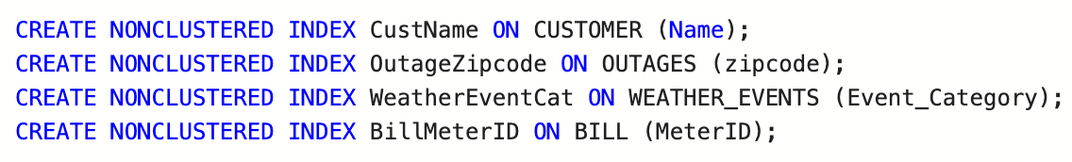
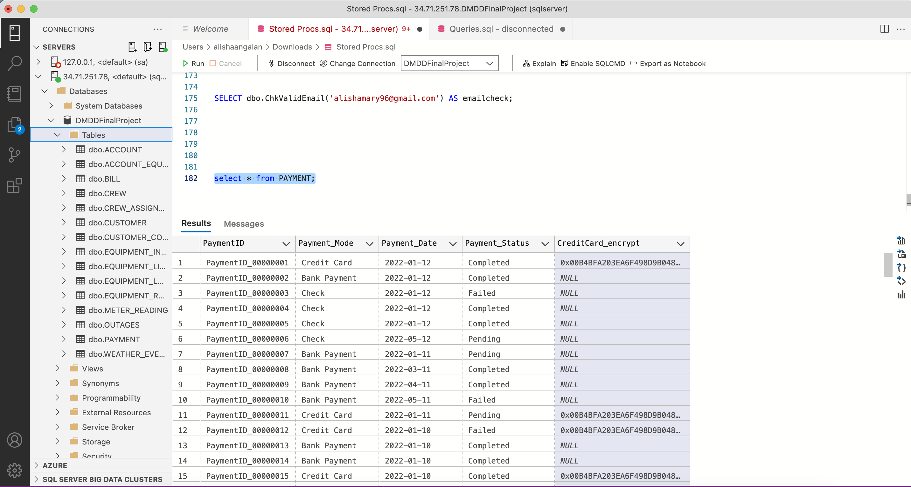
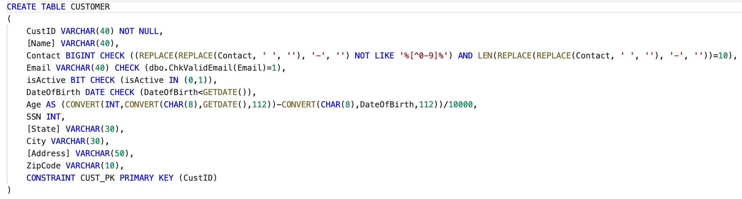
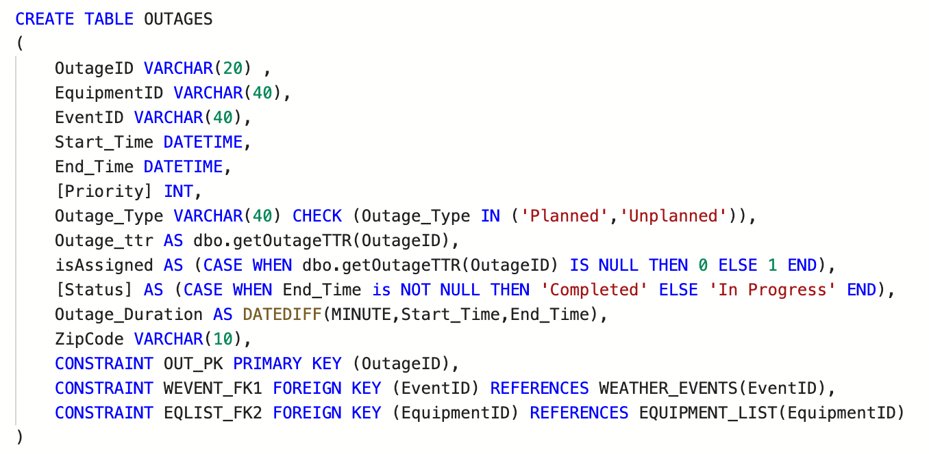
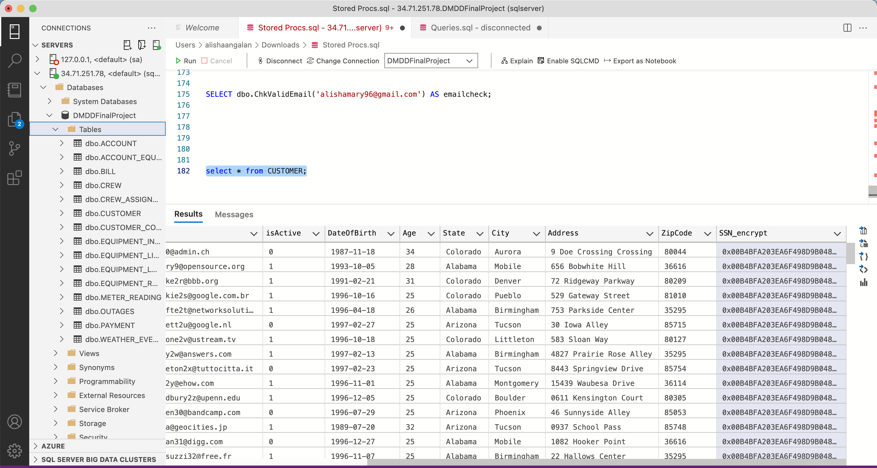
DATABASE OBJECTS – Encryption, Indexes, Computed columns

Slide 9
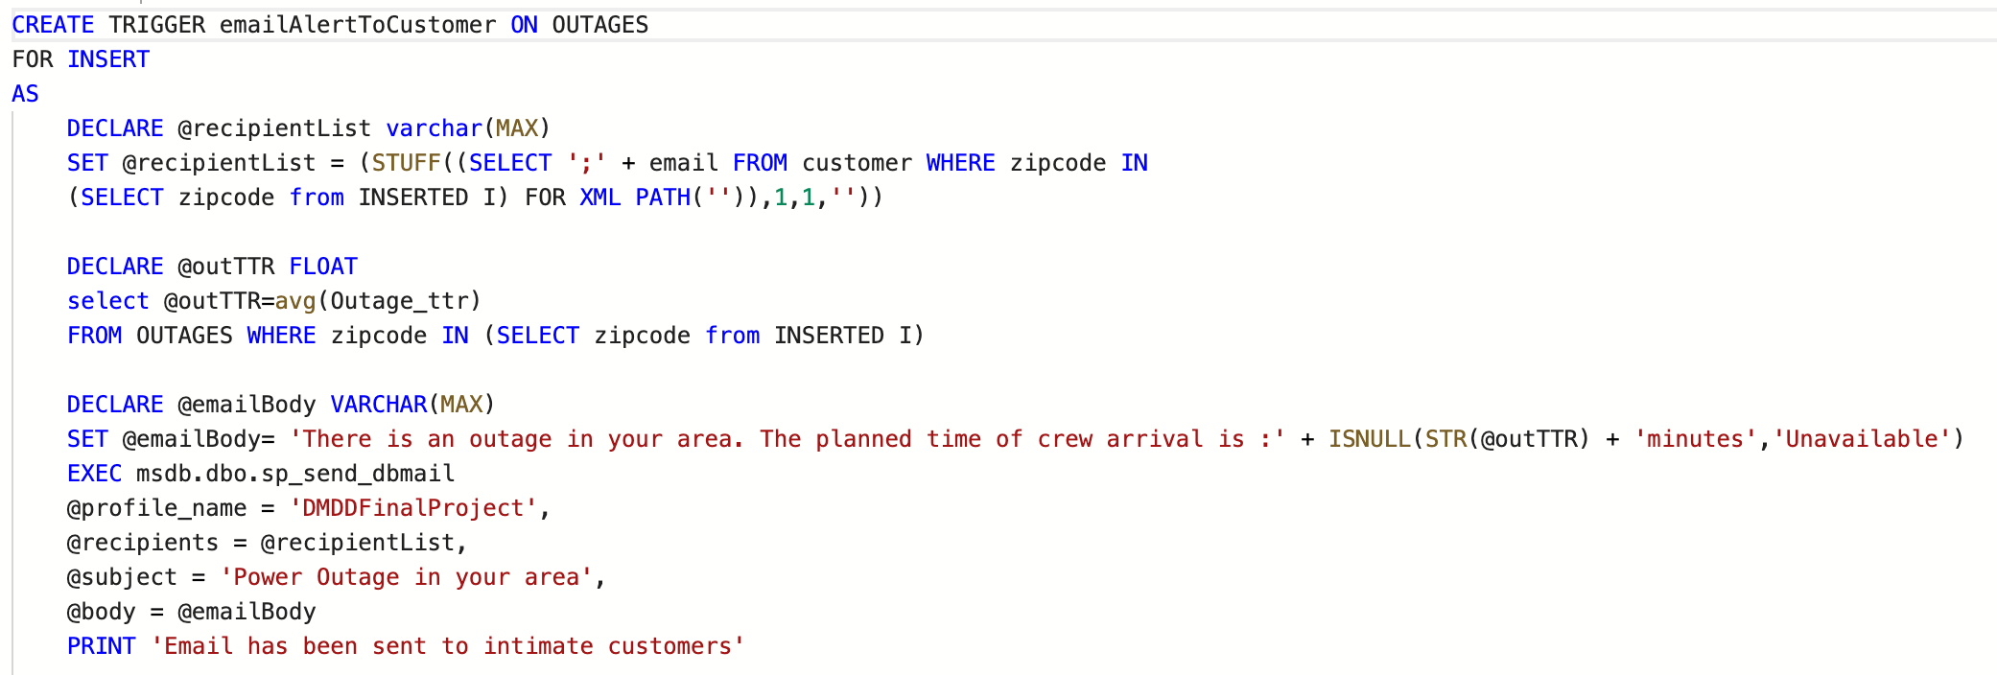
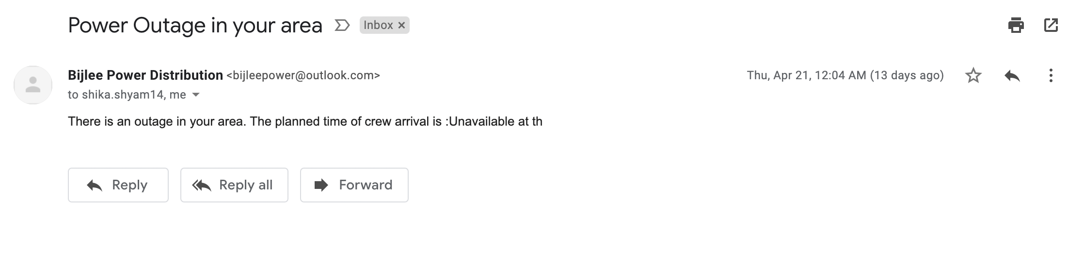
DATABASE OBJECTS – DML Triggers

Slide 10
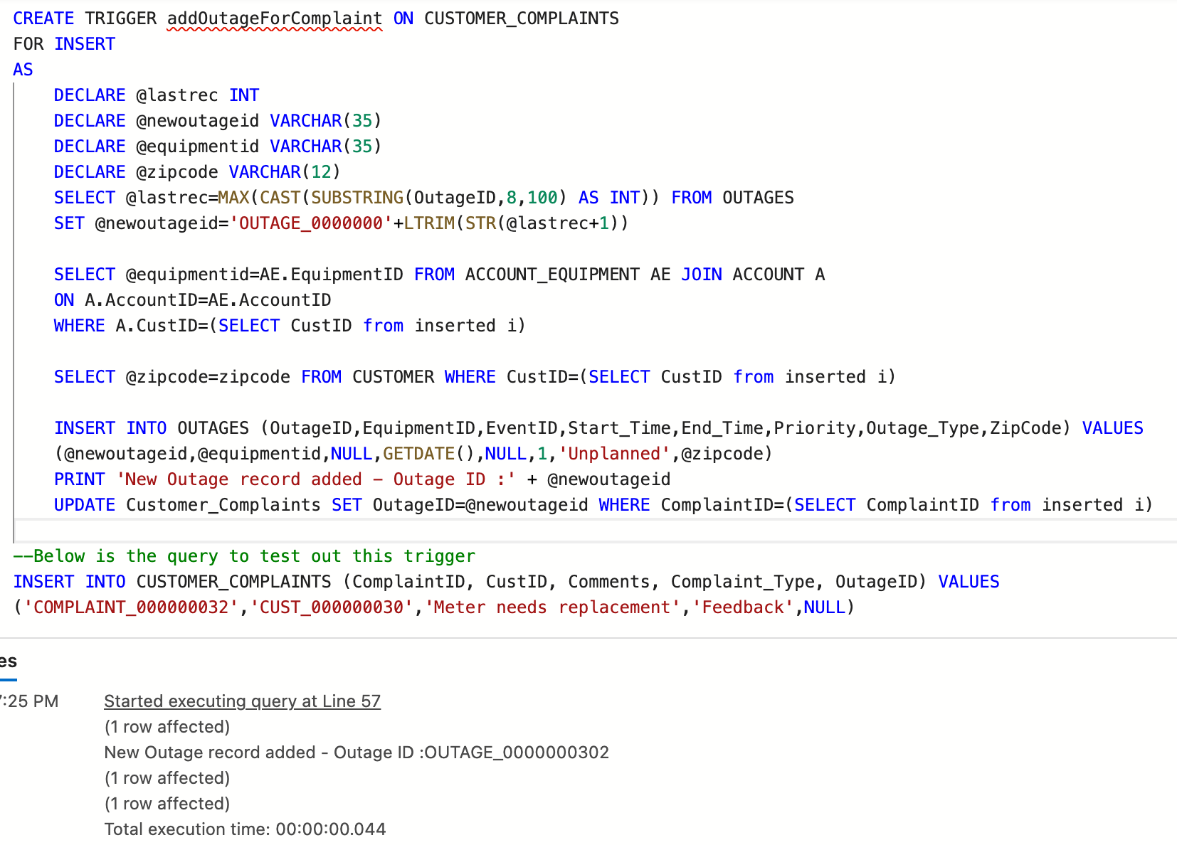
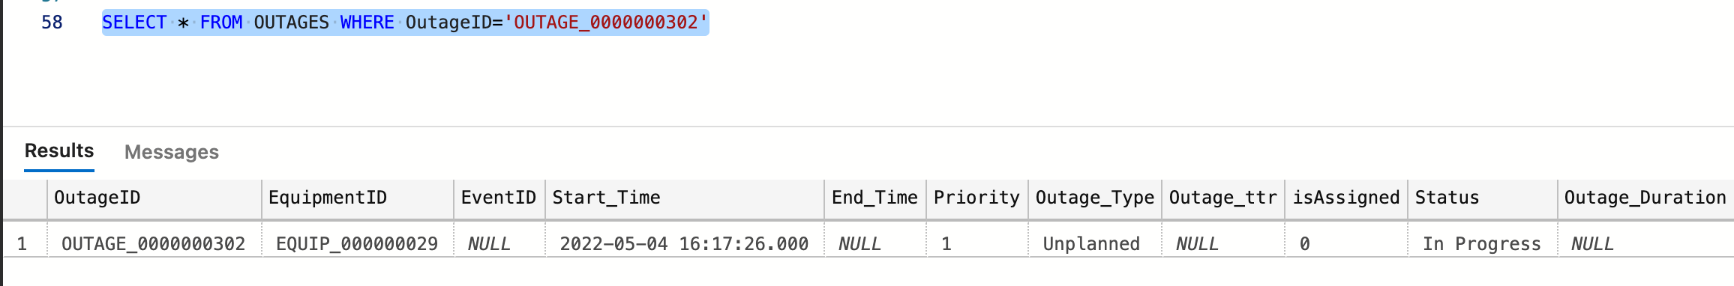
DATABASE OBJECTS – DML Triggers (continued)

Slide 11
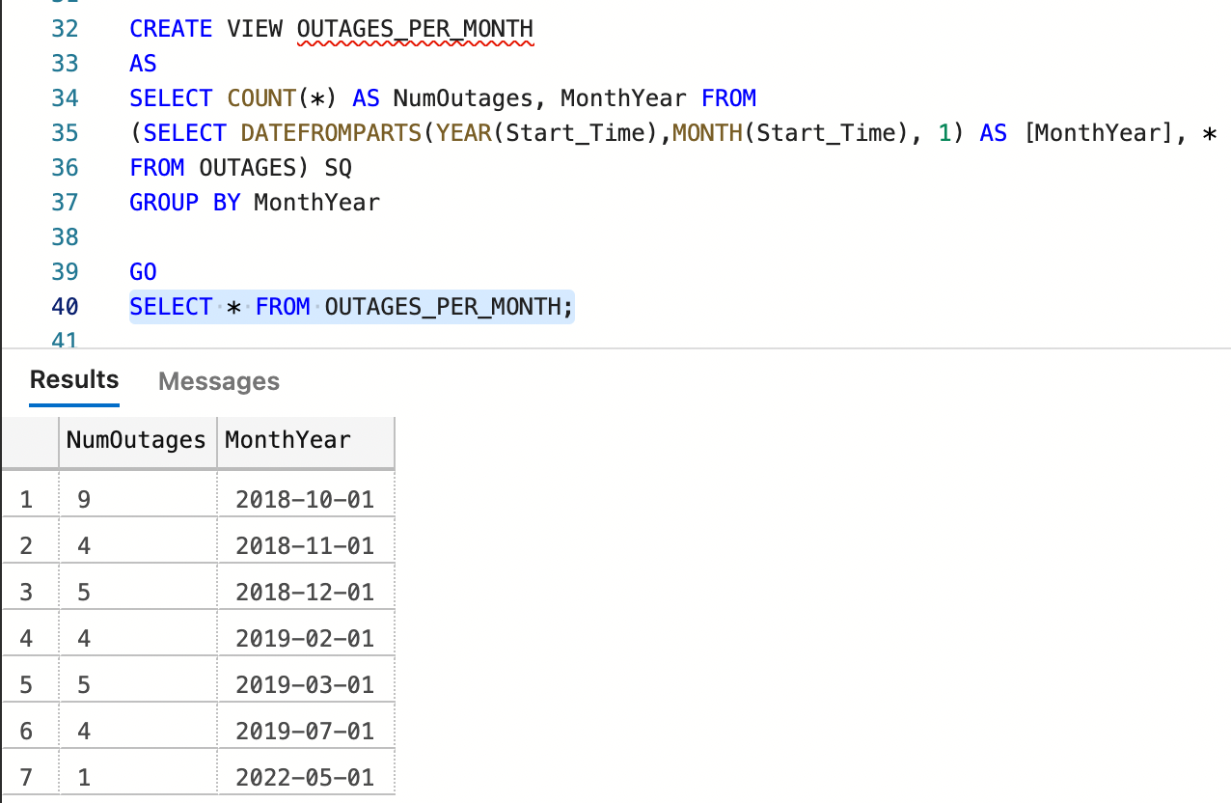
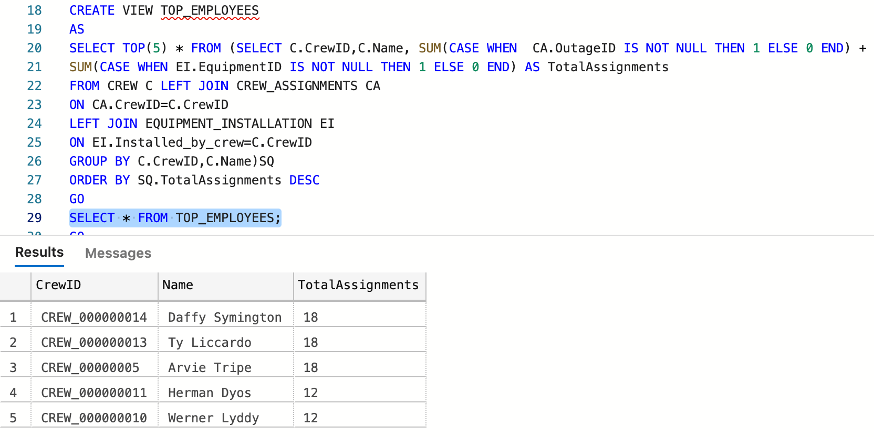
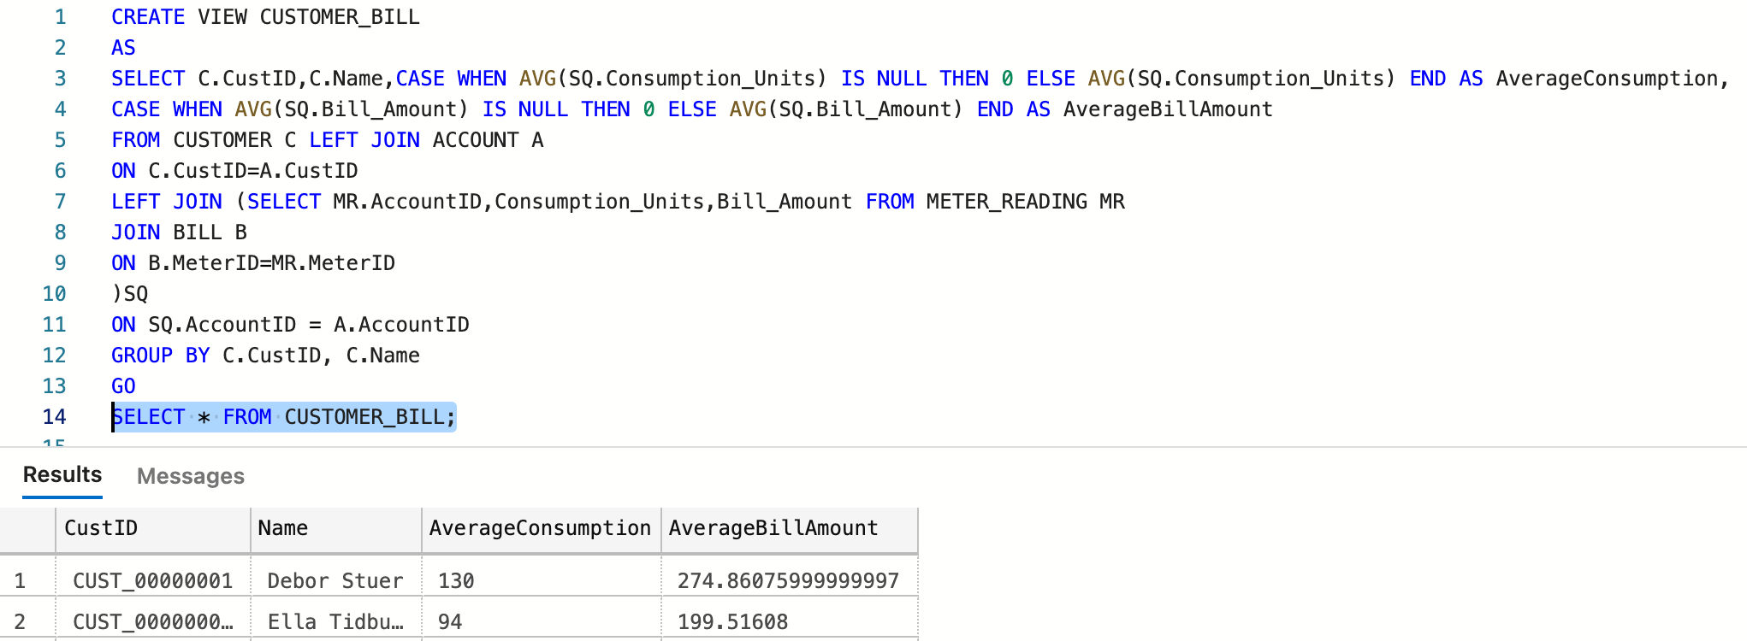
DATABASE OBJECTS – Views

Slide 12

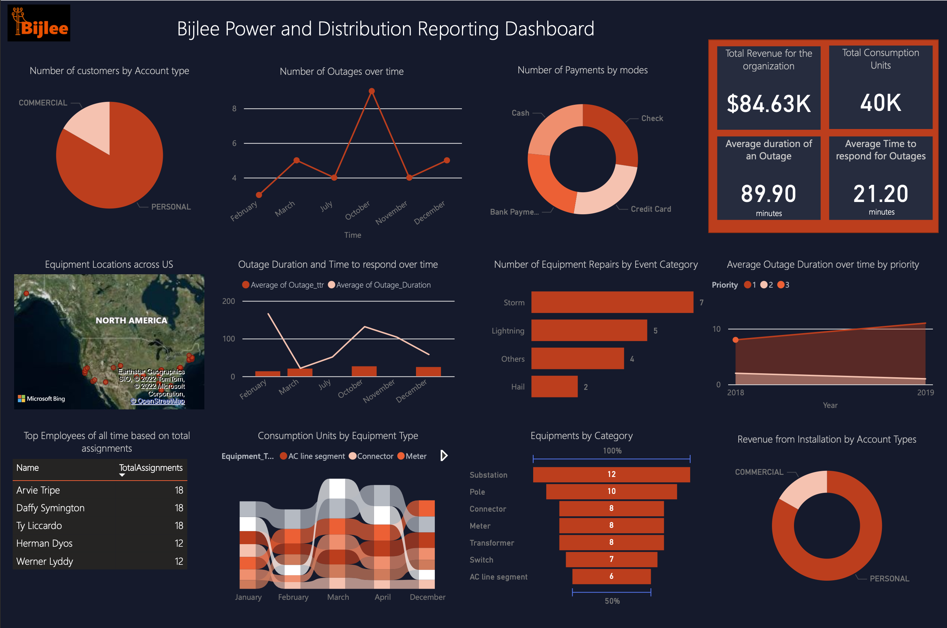
DERIVED INTELLIGENCE - Dashboard

Slide 13






GRAPHICAL USER INTERFACE
MANAGE DATA
QUERY DATABASE
VIEW DASHBOARD
Enables CRUD operations on the tables in the database system
Provides the user with an option to write and execute queries directly on the GUI instead of on the database IDE
PowerBI Dashboard is linked in the website for easy viewing

Slide 14
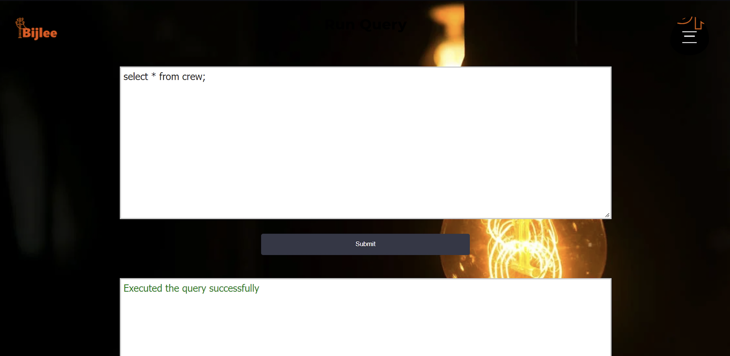
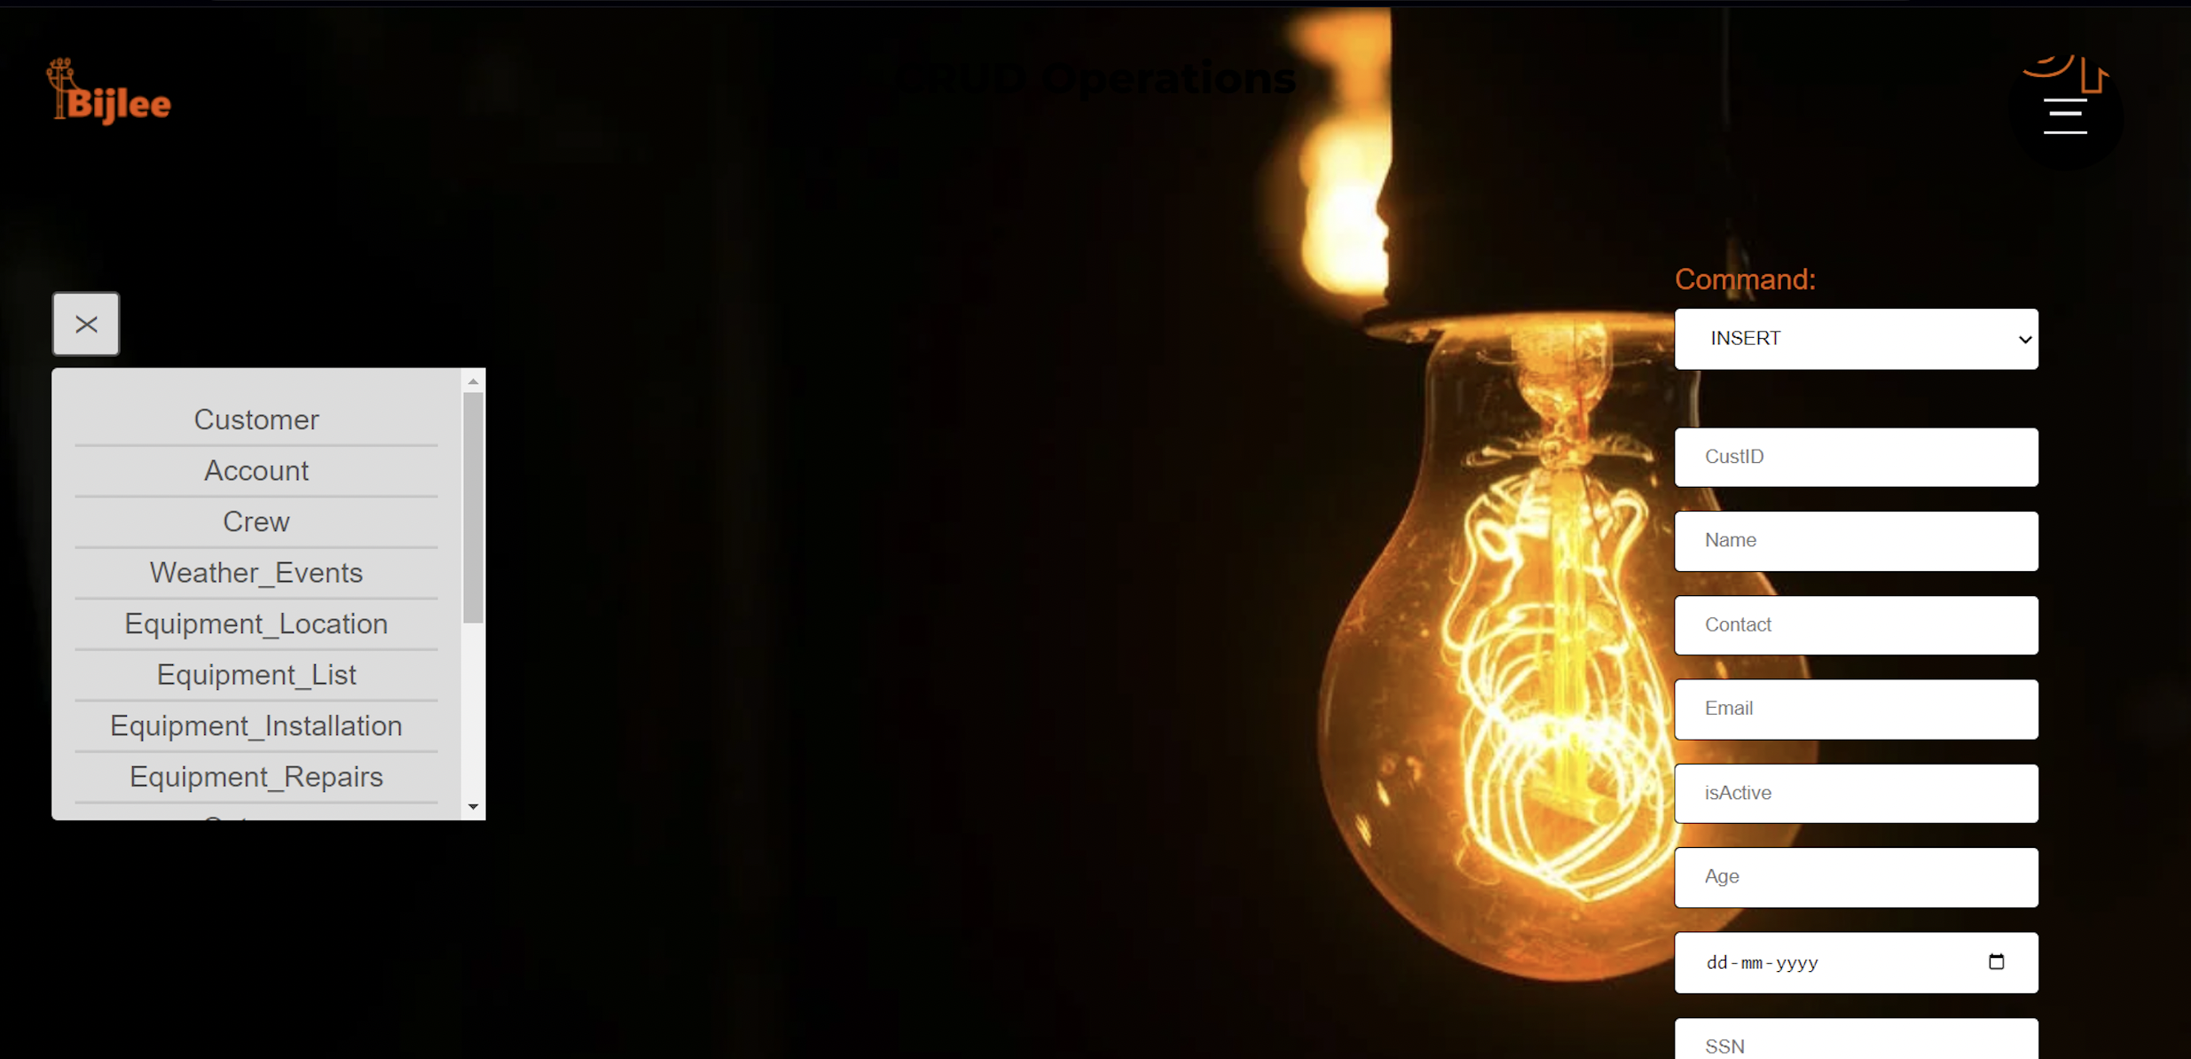
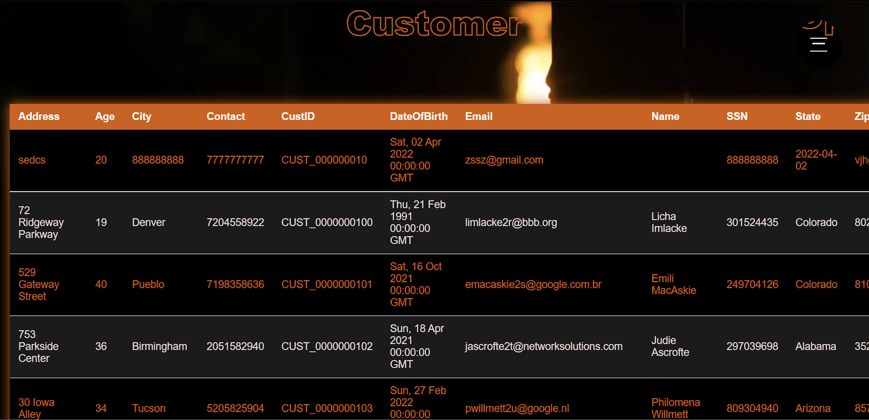

Slide 15

THANK YOU

